Slide 1

Exception Handling
By Min Thet Naing

Slide 2
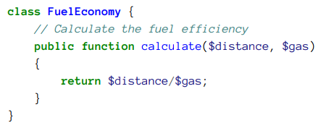
By Min Thet Naing

Slide 3
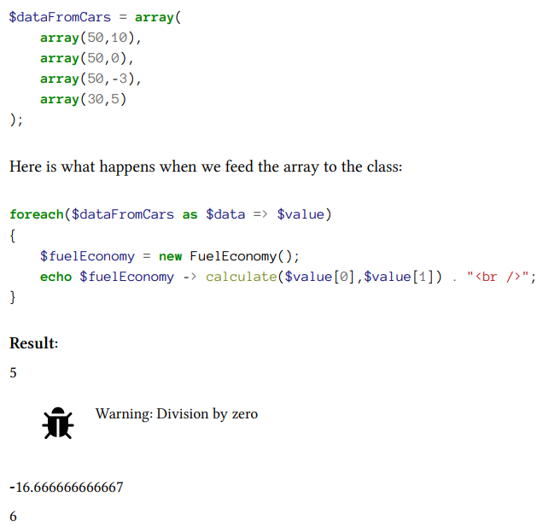
By Min Thet Naing

Slide 4
Throw an Exception
By Min Thet Naing

Slide 5
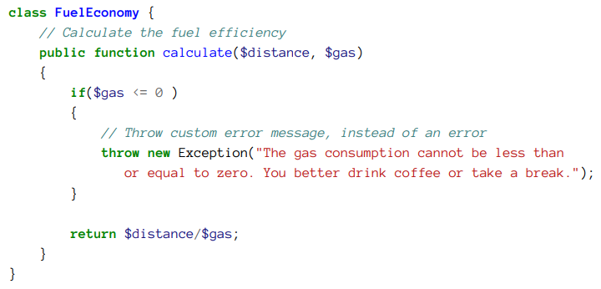
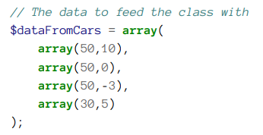
By Min Thet Naing

Slide 6
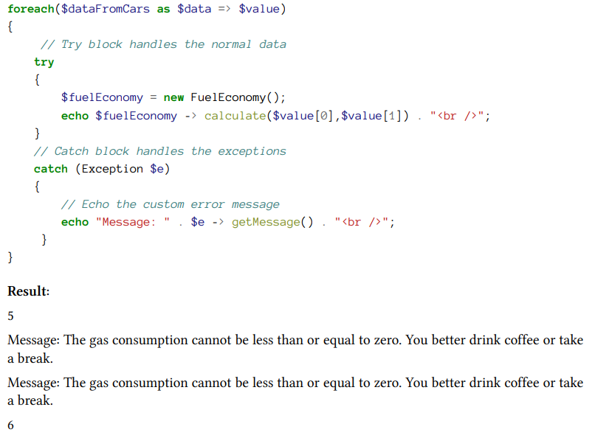
By Min Thet Naing

Slide 7
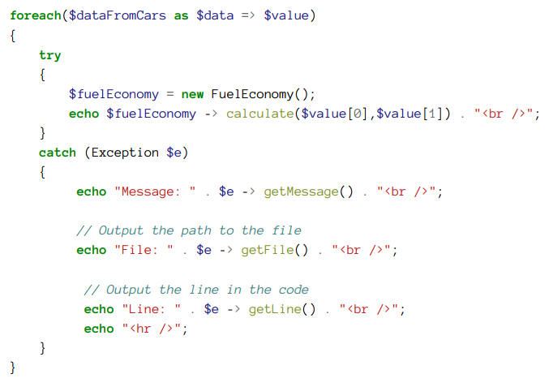
By Min Thet Naing

Slide 8
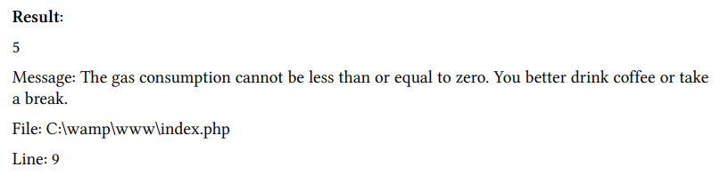
By Min Thet Naing

Slide 9
Writing the exceptions to a log file
By Min Thet Naing

Slide 10
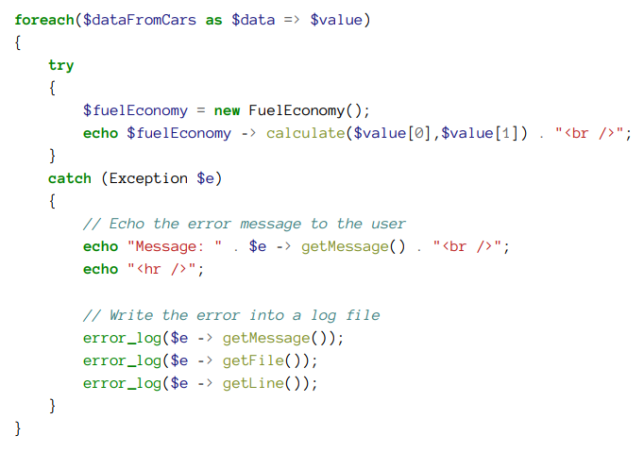
By Min Thet Naing

